Slide 1
SMS Spam Detection
NATURAL LANGUAGE PROCESSING | BUILD - AUDIT - PITCH
Hey, are we still meeting for lunch tomorrow at 1pm?
using Natural Language Processing and Machine Learning
HAM | spam probability 0.00
URGENT! You have won a 1 week FREE membership in our £100,000 Prize Jackpot! Txt WORD to 81010
Faculty: Dr. Nabanita Choudhury, Assistant Professor
BBA (Artificial Intelligence) | Academic Year 2026-27
SPAM | spam probability 0.99
Sarvesh Wani
Sanando Maitra
Priyanshu Akshat
PRN 25030422140
PRN 25030422105
PRN 25030422095

Slide 2

The problem and the data
The problem
5,572
403
Spam SMS carries scams, fake prizes and junk offers.
Goal: label every message as spam or ham (genuine) automatically.
The catch: blocking a real message can cost more than missing an ad.
real SMS messages in the raw file
duplicates removed before splitting (5,169 left)
12.6%
~2x
UCI SMS Spam Collection
Real UK English SMS, each with a label and raw text; a well-known academic benchmark.
spam, so 6.9 : 1 ham to spam imbalance
spam is longer than ham (138 vs 71 characters)

Slide 3
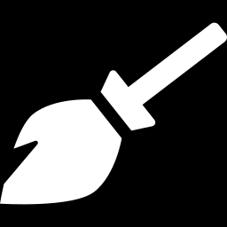
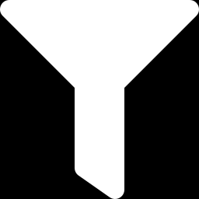
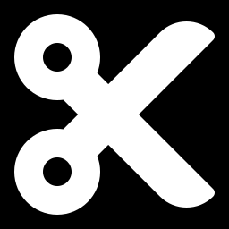
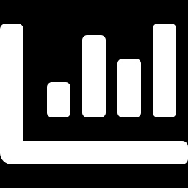
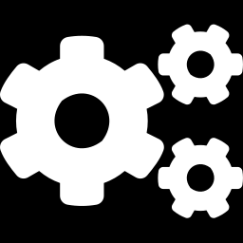
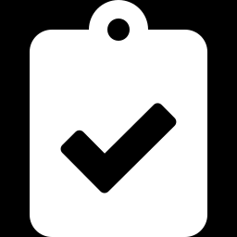
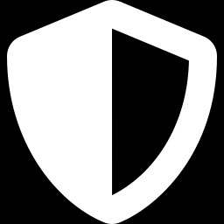
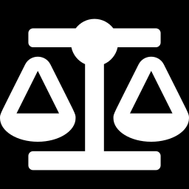
Approach: the NLP pipeline
Clean data
Normalise
Tokenise
TF-IDF
Train
Evaluate
Remove 403 duplicates, leaving 5,169 messages
Lowercase, tag URLs and numbers, drop punctuation
NLTK tokens, stopword removal, lemmatisation
Unigrams + bigrams, top 3,000 features
Stratified 80/20 split, 4 models, seed 42
Precision, recall, F1, ROC-AUC, then audit
Leakage-safe
Imbalance-aware
Duplicates removed before the split; TF-IDF fitted on training text only.
Balanced class weights, judged on precision / recall / F1, not accuracy alone.

Slide 4
Four models, one clear winner
BEST OVERALL
Linear SVM
98.2%
0.927
accuracy
F1-score
0.994
0.015
ROC-AUC
Brier (lower is better)
8 false alarms | 11 missed spam
Naive Bayes: 0 false alarms but 26 spam missed. Logistic Regression: 19 false alarms. Random Forest: 21 spam missed.
Held-out test set: 1,034 messages (131 spam), threshold 0.50. Axis starts at 0.60.

Slide 5


Audit: who gets it wrong?
Text group (spam n) | Naive Bayes | Logistic Reg. | Linear SVM | Random Forest
All test messages (131 spam) | 0.80 | 0.92 | 0.92 | 0.84
Short, <=42 chars (2 spam) | 0.00 | 0.50 | 0.50 | 0.00
Medium, 43-91 chars (12 spam) | 0.50 | 0.67 | 0.67 | 0.33
Long, >91 chars (117 spam) | 0.85 | 0.95 | 0.95 | 0.91
Casual / slang (37 spam) | 0.70 | 0.89 | 0.89 | 0.84
Plain text (6 spam) | 0.50 | 0.67 | 0.67 | 0.50
False alarms hit short, plain chat
Logistic Regression precision drops to 0.08 on short and 0.21 on plain messages. "Call me when u're done" gets flagged.
Missed spam hides in medium and slang texts
Random Forest catches just 0.33 of medium-length spam; Naive Bayes only 0.70 of slang spam.
Recall = share of real spam caught. Red < 0.60 | amber 0.60-0.84 | green >= 0.85

Slide 6
Audit: what the models learned
Words that push toward SPAM
...and that is also the weakness
txt
call
mobile
free
reply
Genuine messages flagged by Logistic Regression:
claim
prize
ringtone
"Call me when u're done..."
p = 0.55
"Are you free now?can i call now?"
p = 0.83
Words that push toward HAM
ok
home
later
da
lor
"I'm at work. Please call"
p = 0.80
Linear SVM even memorised "arsenal" (football-ticket promos), so it may not transfer to new campaigns.
All four models agree on these cue words (coefficients, log-ratios and feature importances).

Slide 7
Key finding: a hidden bug
clean_text() - WHAT ACTUALLY RUNS
text = text.lower()
text = re.sub(r'£|\$', ' CURRENCY ', text)
text = re.sub(r'[^a-z\s]', ' ', text)
The last line deletes every capital letter, including the URL, CURRENCY and NUM tags.
Raw SMS
Call 09099726395 now at www.x.com for £100
What the model sees
call
Linear SVM: F1 0.927 to 0.969, false alarms 8 to 1
Test run with lowercase placeholders; app unchanged. Axis starts at 0.80.

Slide 8
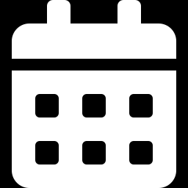
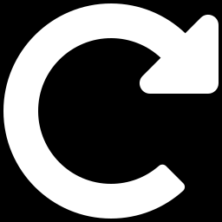

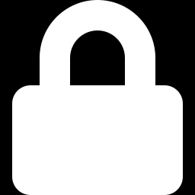
Honest limitation: tiny subgroups
2
6
12
spam messages in the short-text group
One miss moves recall by 50 points
spam messages in the plain-text group
One miss moves recall by 17 points
spam messages in the medium group
One miss moves recall by 8 points
Dated, UK-centric, English-only data
One random split, no confidence intervals
Modern delivery and bank-link scams are not represented.
Small gaps between models should not be over-read.
Explanations are proxies, not SHAP / LIME
Vocabulary lock-in
Random Forest has no signed weights, so direction is inferred.
Spam that avoids the learned promo words looks like ham.

Slide 9




Conclusion and next steps
RECOMMENDATION
NEXT STEPS
Linear SVM, after fixing the placeholder bug
Fix URL, currency and number placeholders in the app
Add cross-validation and confidence intervals
Default choice: best F1 (0.927, 0.969 after the fix) and best calibration (Brier 0.015).
Naive Bayes if a false alarm is unacceptable (0 false positives).
Logistic Regression if a missed spam is the bigger risk (recall 0.92).
Train on newer, larger SMS data with modern scams
Try embeddings / BERT; keep a human in the loop
Thank you | Questions?

